Slide 1
Helping Beer Making by Research on Yeast
Fusheng Tang
University of Arkansas at Little Rock

Slide 2
Factors affecting the commercial value of beer
Unwanted alcoholic byproducts
Unpleasant molecules
Shelf life

Slide 3
Outline
1. Enhancing ethanol production
Removing unpleasant molecules
3. Preventing cloudy beer during shelfing

Slide 4
Part I: Enhancing ethanol production
glucose
enzymes
ethanol, CO2
Several enzymes in glycolysis (breaking down of glucose to ethanol) bind to actin cables (Araiza-Olivera et al., 2013)

Slide 5
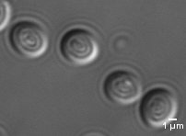
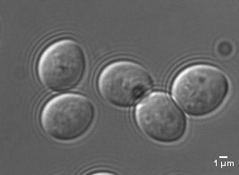
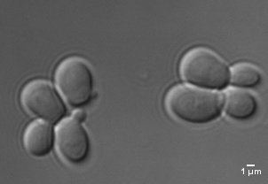
We have a lab strain with large cell size
Wild type
OSH6ox
OSH6ΔCCox

Slide 6
Our lab strain (Osh6ox) has more actin cables than wild type control
Wild type
Osh6ox
Osh6ox-deltaCC

Slide 7
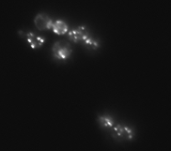
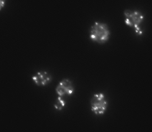
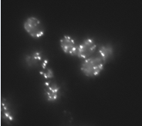
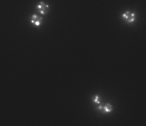
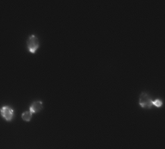
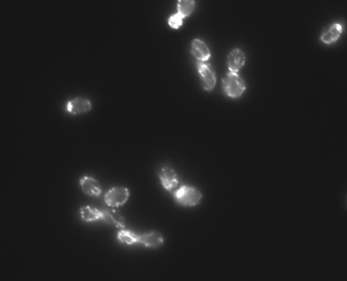
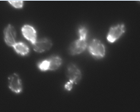
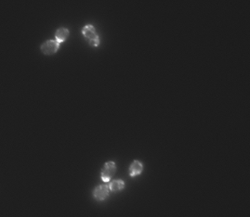
Our strain’s actin cables are more tolerant to ethanol stress
Wild type
373
406
431
YEPD
Yeast medium
Yeast medium with
10% Ethanol

Slide 8
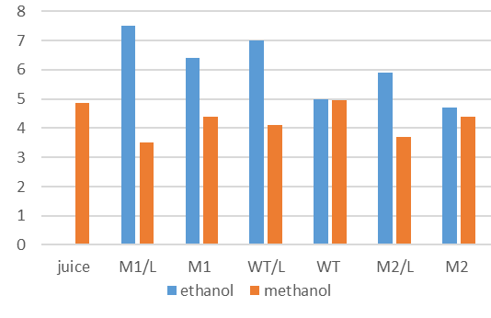
Our strain produces more ethanol but less methanol in apple juice fermentation experiments
Y axis unit: ethanol: 10 mg/ml; methanol: mg/ml

Slide 9
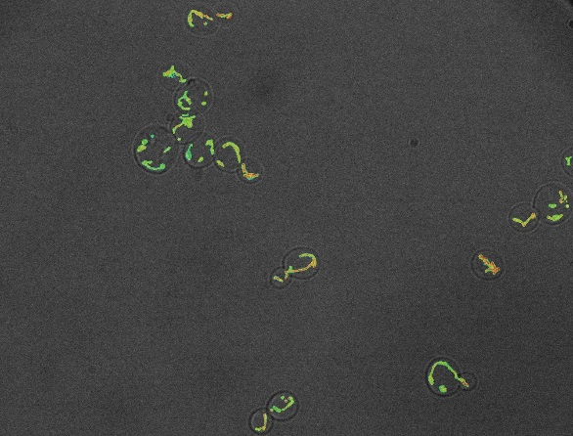
Our strain has more reduced mitochondria than its wild type control
Wild type
Osh6ox
Better working mitochondria (right panel) saves energy in making more mitochondria. Similar to this rationale, blocking the autophagy (self eating) of mitochondria also increases the production of ethanol during Sake fermentation (Shiroma et al., 2014).

Slide 10
Part II: Depletion of unpleasant molecules

Slide 11
Converting alpha-acetoacetate to acetoin will minimize the production of diacetyl
glucose
alpha-acetolactate
diacetyl
(butter taste)
enzymes
non-enzymatic
ethanol, CO2
(Ehsani et al., 2009)

Slide 12
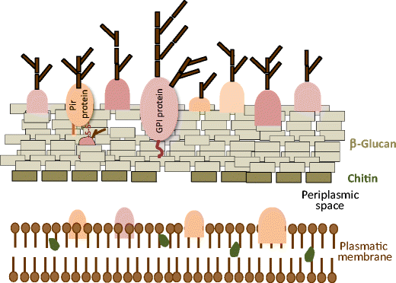
Yeast cell surface display technology
(Andreu and
del Olmo
2018)

Slide 13
Examples of using cell display to change flavors
Expressing the enzyme ALDC (alpha-acetolactate decarboxylase) on the cell surface decreases diacetyl by 30% (Cejnar et al., 2016).
2. Expressing the enzyme BDH (2,3-butanediol dehydrogenase) decreased acetoine by 90% and diacetyl by 50% (Cejnar et al., 2017).
3. We constructed our own system to express enzymes on the cell surface.

Slide 14
Part III: Preventing cloudy beer during shelfing
Two major causes for cloudy beer during shelfing:
Bacterial contamination
Haze (a complex between polyphenols and broken proteins)

Slide 15
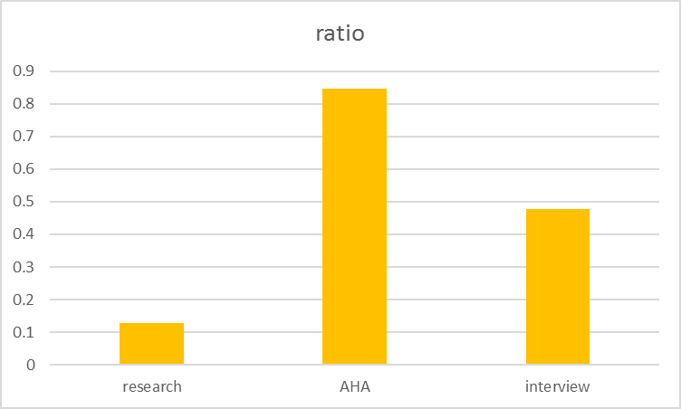
Bacterial contamination is common for craft beer
Three independent resources show that bacterial contamination is a problem for beer-making
These contaminations wasted at least $ 15 million per year for USA (0.5 million batches X $30 (raw materials) /batch (5 gallon)).
J. Institute AHA our interview
Brewing top 10 of home brewers
2013, followed
118(4) questions
153/1203 55 k / 65 k 22/46

Slide 16
Current methods on bacterial contamination
UV treatment (Hosseini et al., 2011) kills bacterial cells but also some yeast cells.
2. Viruses (phages) can kill bacterial cells (Feiyereisen et al., 2019) but species-specific.
3. Natural anti-bacterial compounds from plants (similar to Hops extracts), e.g. extracts from Date palm leaves) (Harris et al., 2018), may change the flavor.
4. Natural anti-bacterial compounds from animals. Chitosan treatment kills bacteria in wort fermentation (Gil et al., 2004) but may affect sea food-allergic persons.

Slide 17
Our Solution
l
Bacterial
cell
Our modified yeast
Wild type Our proprietary
yeast yeast strain
Lysozyme
Large cell surface area in our strain allows us to attach more bacterial-lysing enzymes.

Slide 18
Haze
Haze formation:
colloidal particles formed by the interactions between polyphenols and broken proteins with proline (one amino acid) (Wu and Siebert, 2002)
Solutions:
Attaching proline-rich peptides on the surface of yeast cells can deplete 30% of polyphenols during fermentation (Cejnar et al., 2017).
Our strain secretes less protease and produces less broken proteins.

Slide 19
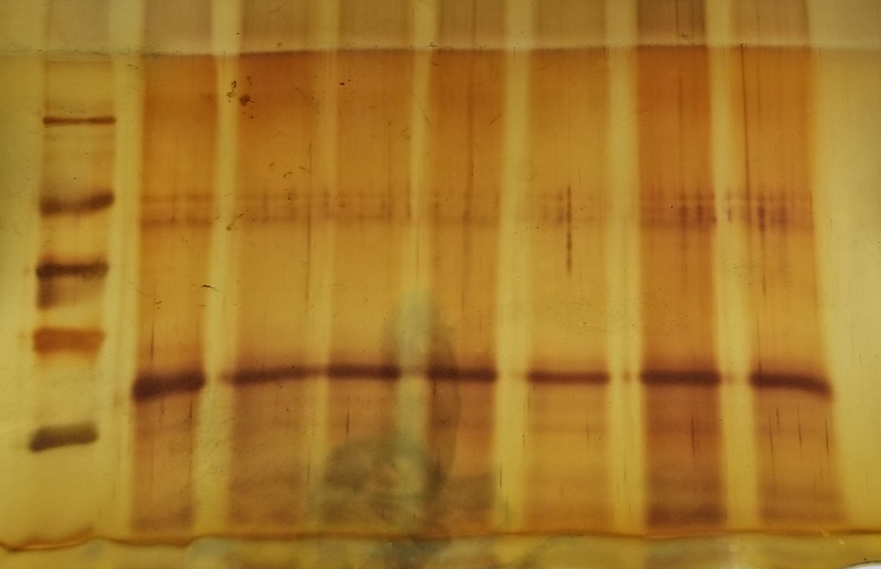
Our strain maintains more apple proteins during fermentation of apple juice
M Juice M1/L M1 WT/L WT M2/L M2
66 kD
45 kD
35 kD
25 kD
18 kD
an apple protein that was broken by wild type yeast strain but not by our mutants

Slide 20
Summary
We have yeast strains that produce more ethanol and less methanol.
We have our unique system to attach enzymes on the cell wall.
We can modify your strains to maintain your favorite flavors of beer and extend the shelf life.

Slide 21
Acknowledgements
FermentARs: Dr. Jim Winter, Zach Burnett
UALR: Ilham Kadhim, Nazneen Begum
Columbia Univ: Dr. Liza Pon, Dr. Pin-Chao Liao
fermenters: Nolan Buffalo, Samuel R. Atcherson
Delta-I fund start-up winter cohort
UALR-ORSP seed grant
UALR-CALS fellowship

